Slide 1

Rate my Peer

Slide 2
Team Members
Hashim Alkhateeb - Mobile, Web, Backend Developer
Kazi Amin - Mobile Developer
Adam Bawatneh - Project Manager
Brittany Clark - Web Developer
Aisha Fathalla - Web Developer
Andre Hebra - Mobile Developer
Connor Rick - Backend Lead Developer
Muzamil Shamsi - Web, Backend Developer

Slide 3
















Technologies Used
draw.io
Google Docs
Discord
GitHub
VSCode
ChatGPT
DigitalOcean
Flutter
PostgreSQL
Postman
Figma
FileZilla
CSS
HTML
JavaScript
Hopscotch

Slide 4
Things that went well:
Team Cohesion: Our team was largely built before the semester even started. We got to know each other better during the semester, and by the time large projects started, we had a good understanding of each other’s strengths and weaknesses.
Teamwork: Our team worked well together, with every member putting in their fair share of the work. We didn’t feel that any members were loafing around, and that allowed us to take this project as far as we did.
Previous Experience: Many of our members had some previous experience with the frontend and backend technologies used in this project, allowing us to partially jump over the hurdle of learning the technology we needed.

Slide 5
Things that did not go well:
Database: MongoDB proved to be difficult to work with because it doesn’t have explicit rules for relational data, which our data was. We moved to using PostgreSQL hosted on Supabase as a result. While this took time away from implementing new features, the change made working with our data significantly easier. This means that the project is more expandable long-term.
Time: The scale of the project was very large compared to the time we had to implement it, and we wanted to add more than we were able to do. We believe that this would make a good Senior Design project, and that having that much time would be a major advantage in achieving the vision we have for this project.

Slide 6
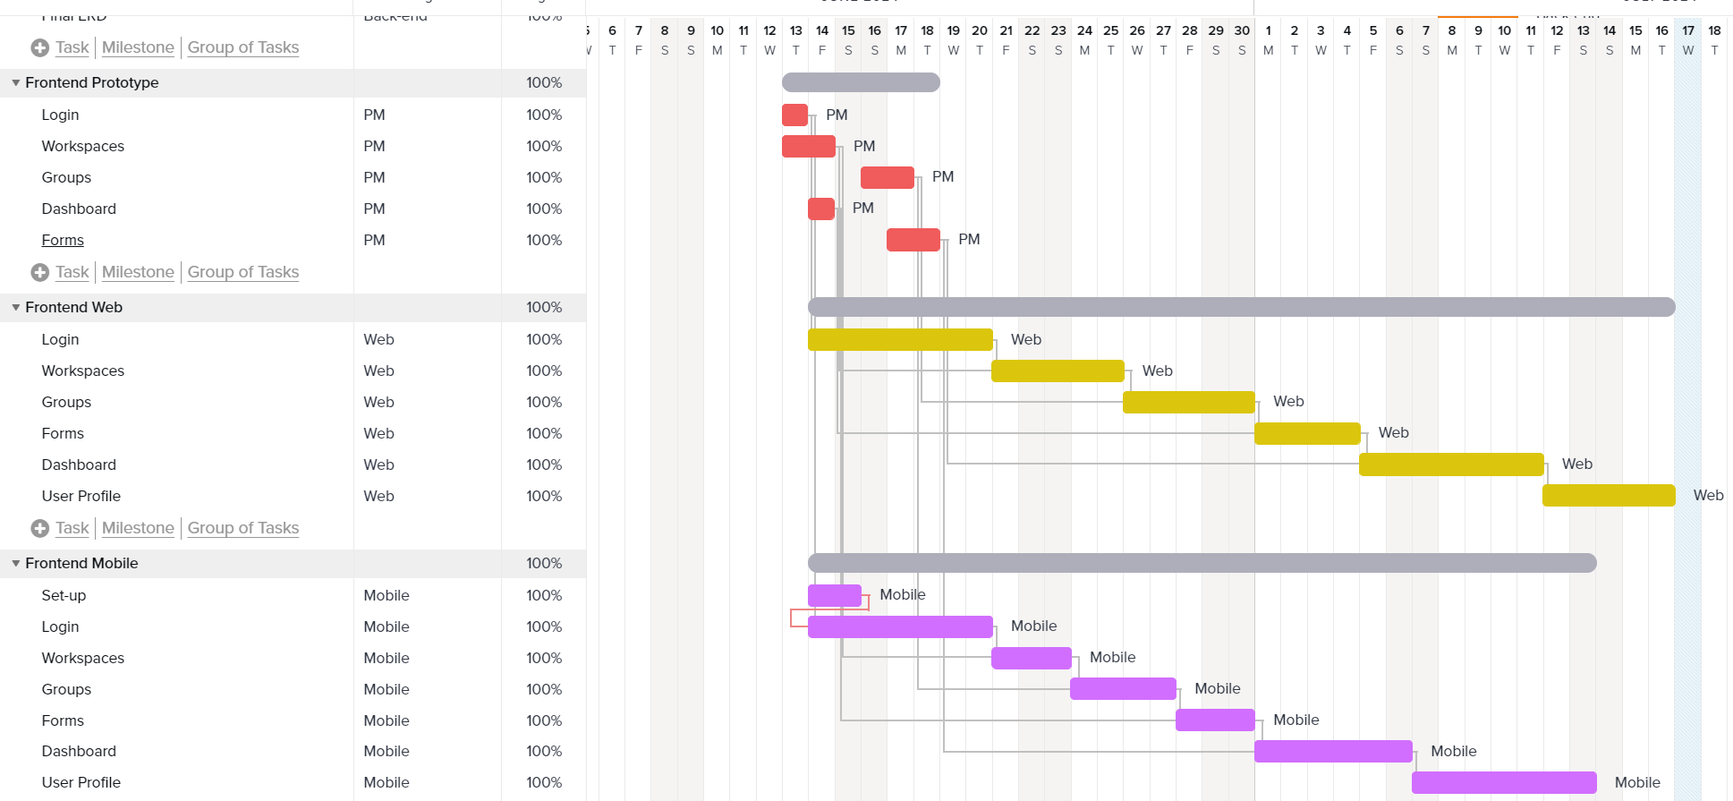
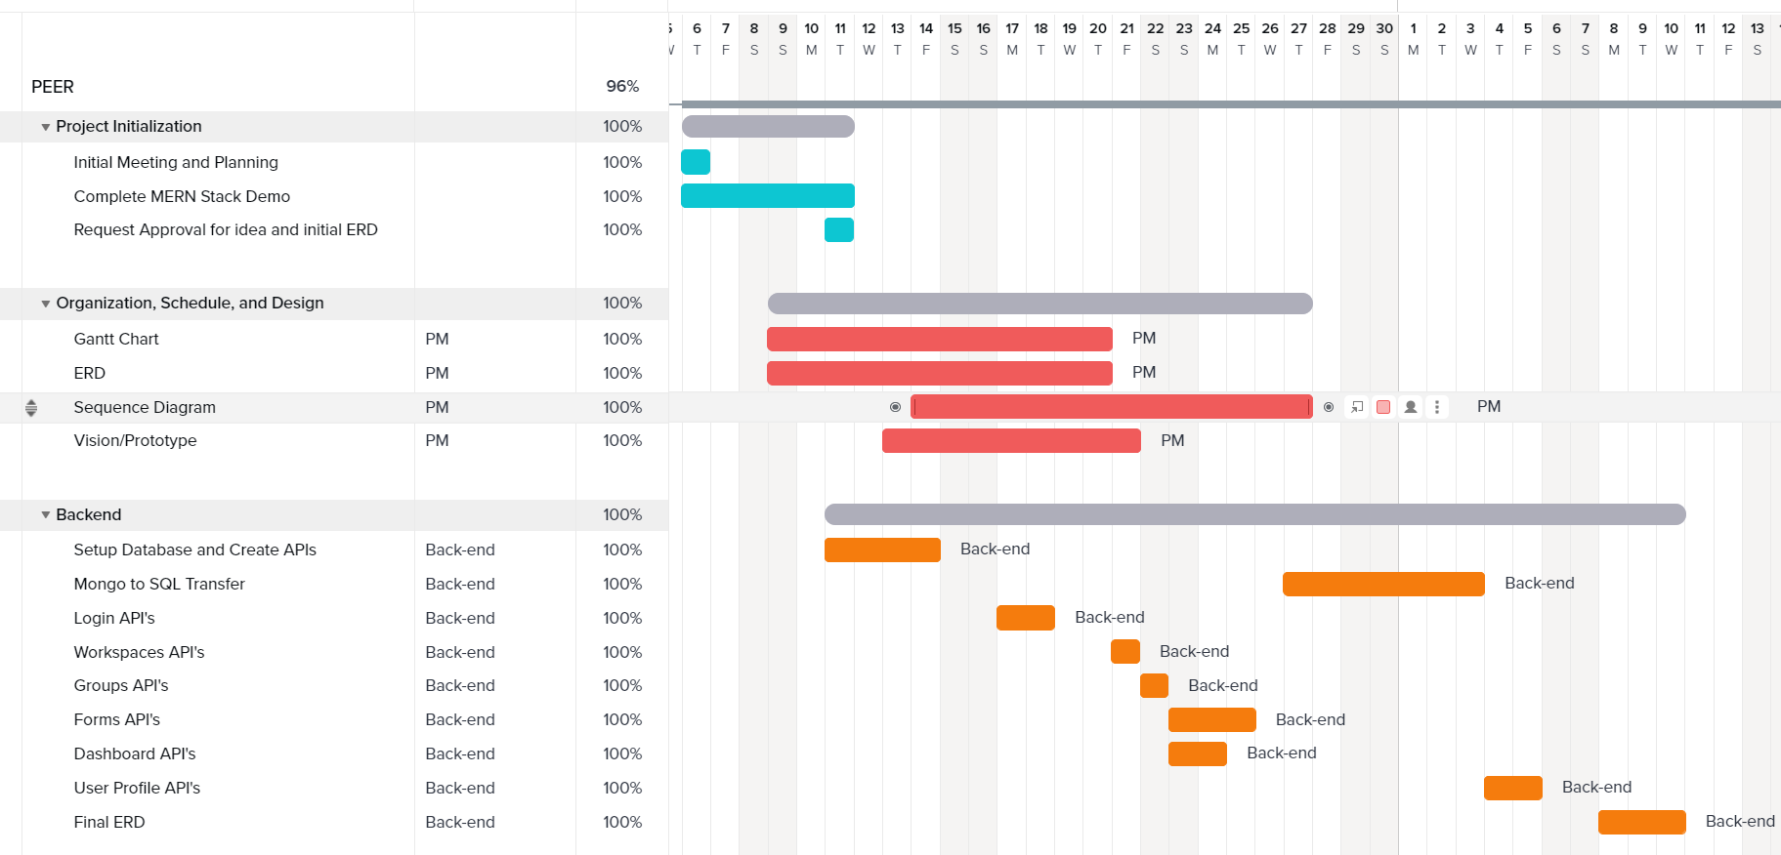
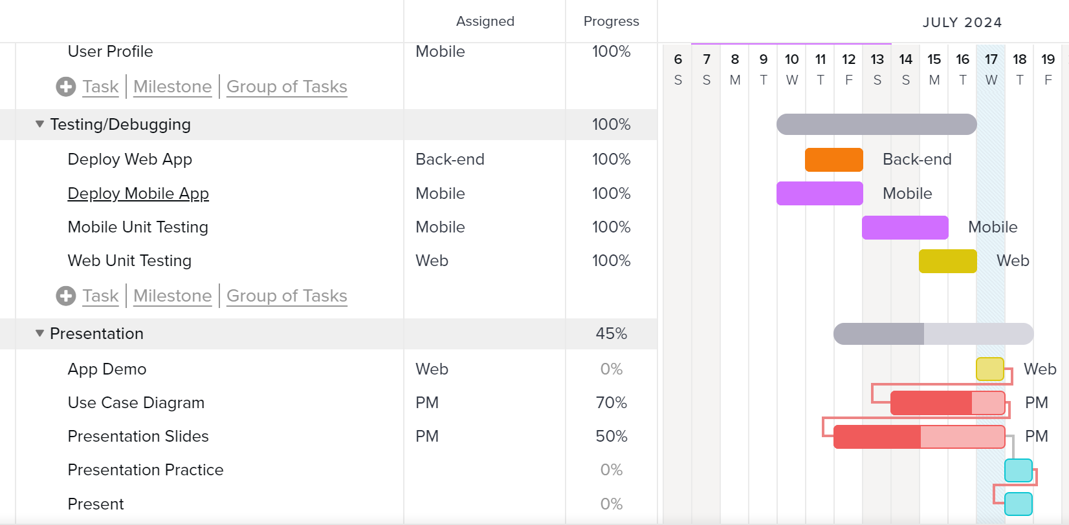
Gantt Chart

Slide 7
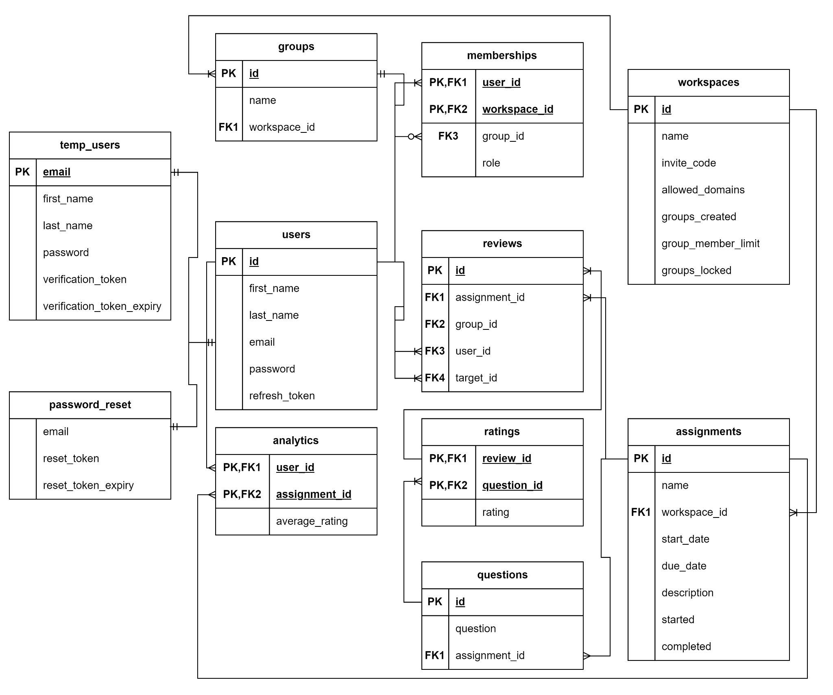
ERD

Slide 8
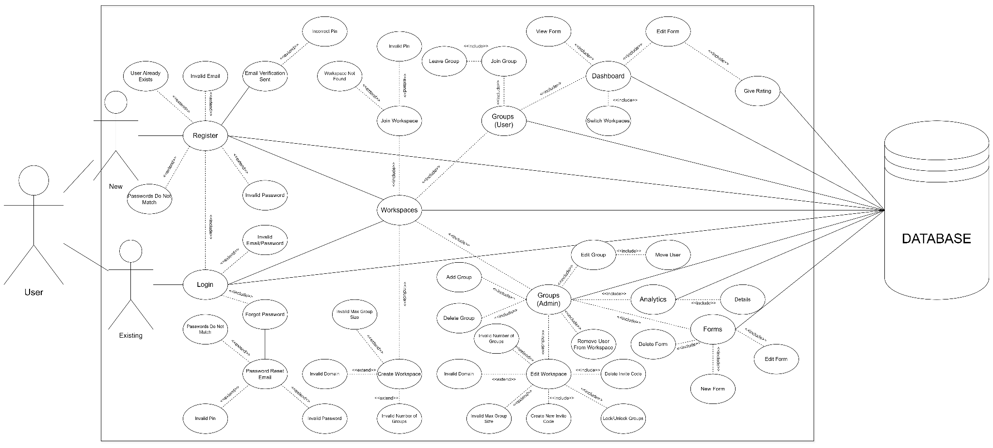
Use Case Diagram

Slide 9
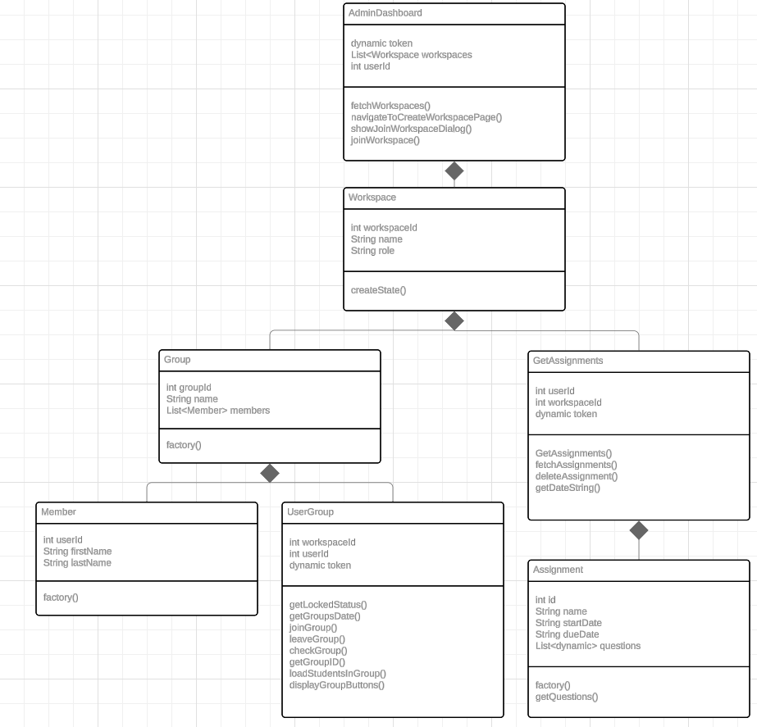
Class Diagram

Slide 10
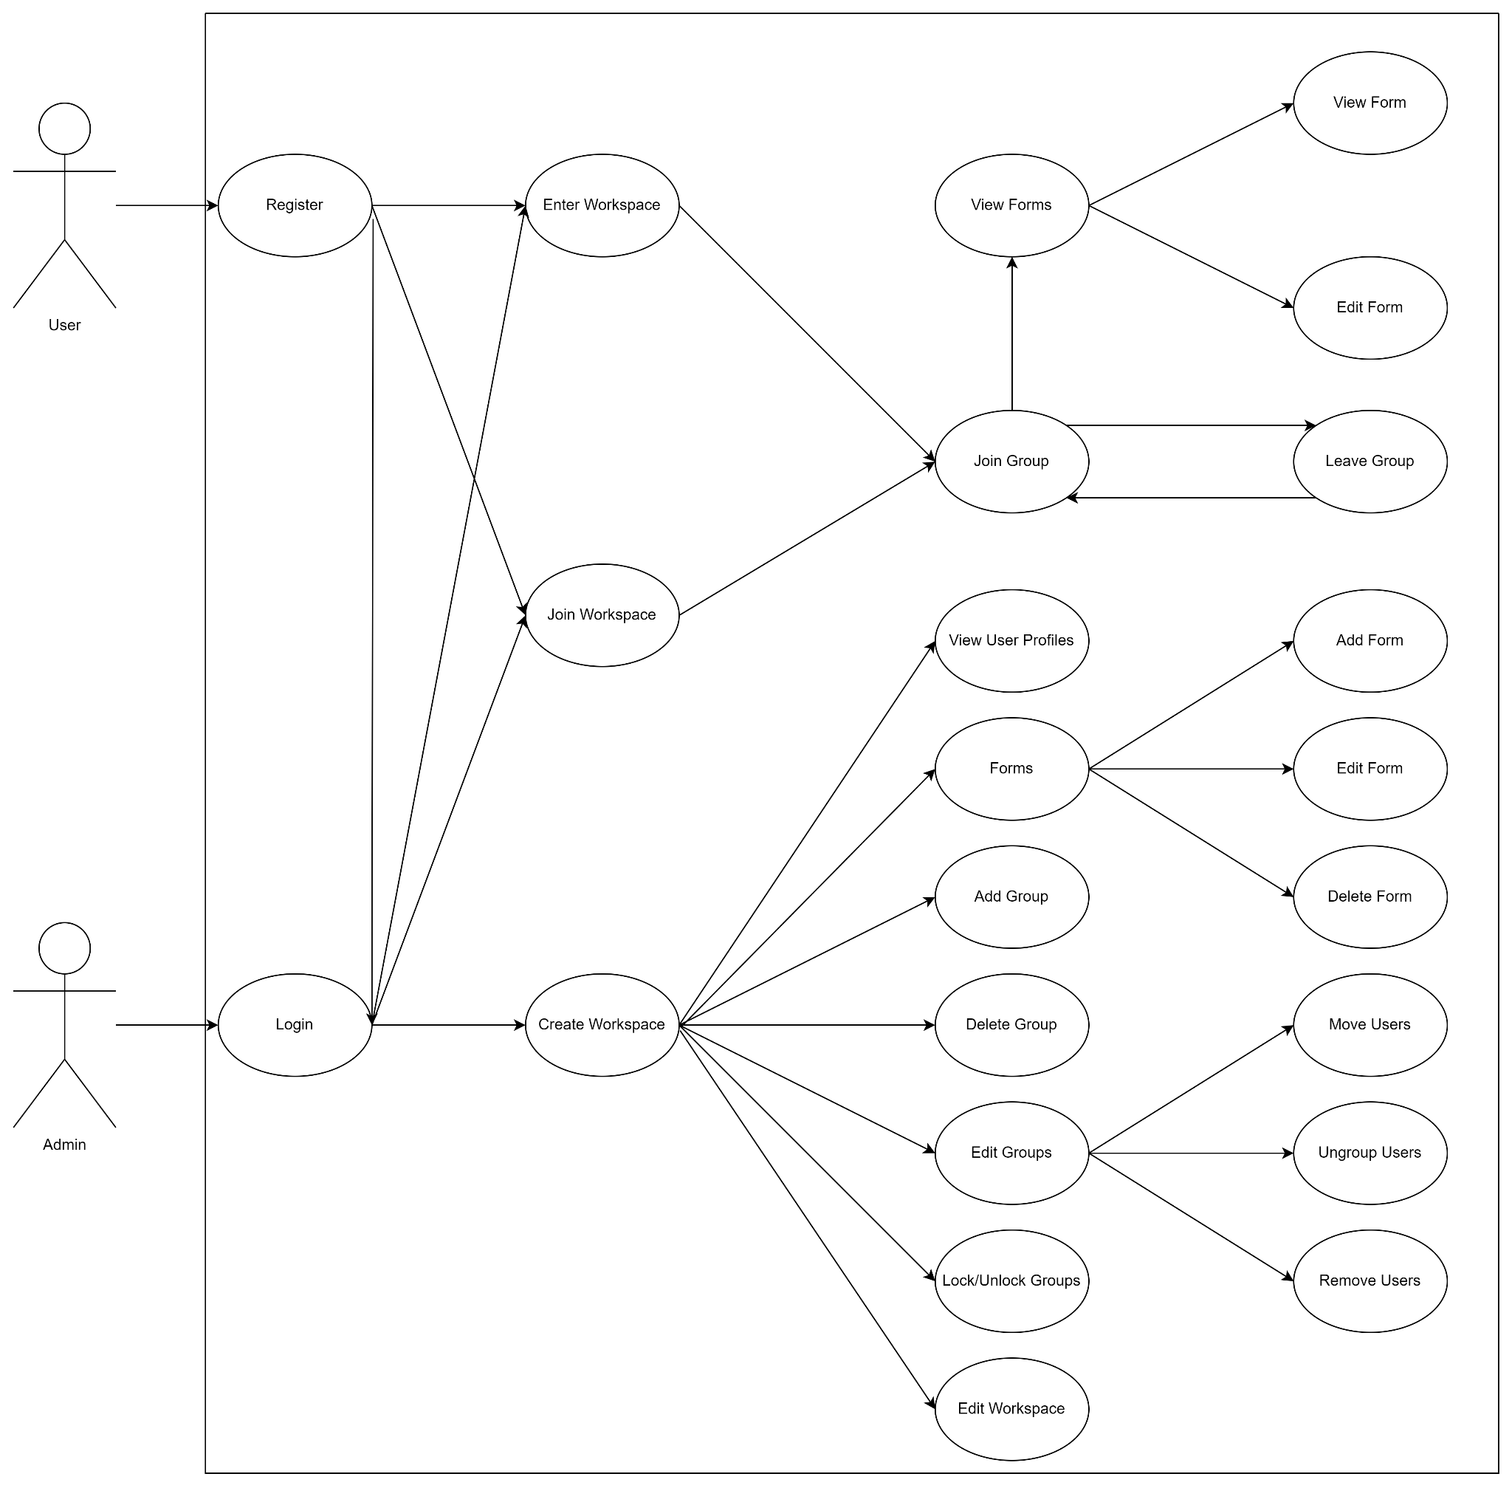
Sequence Diagram

Slide 11
Prototype
https://docs.google.com/document/d/1FnLrfNBbUooriD5M-cbIUnZnlIr-c2FTNhQDXDMyFlc/edit?usp=sharing

Slide 12
https://app.swaggerhub.com/apis-docs/CKR20004/PEER/1.0.0#/
API

Slide 13
Unit Tests
https://docs.google.com/spreadsheets/d/11nZtQWd28m31ZZhzPNto0cFOzBIiE_IqCURT-B3LYBQ/edit?usp=sharing

Slide 14
App
http://ratemypeer.site/

