Slide 1
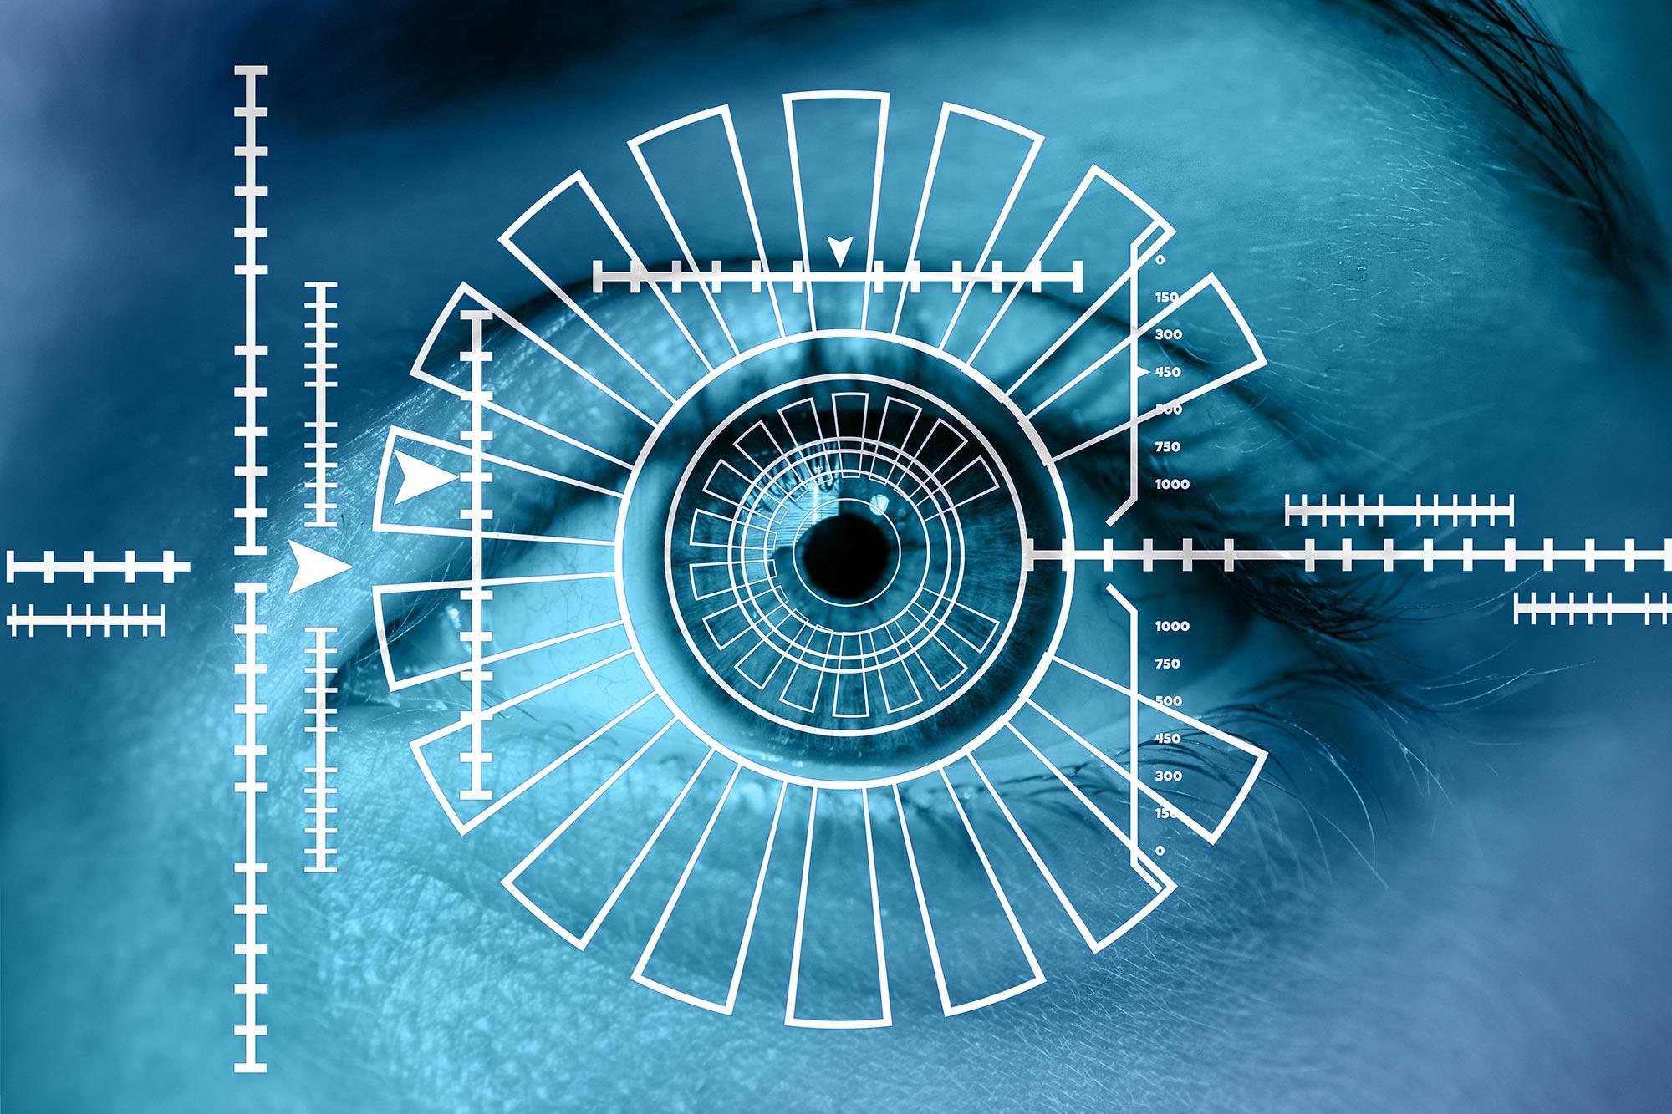
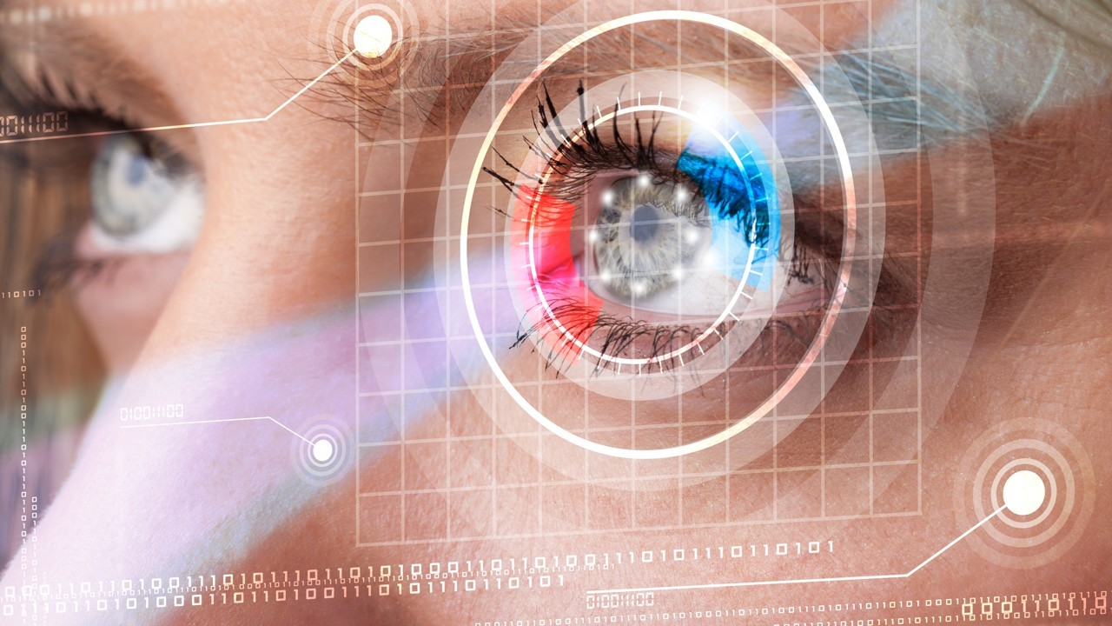
L14 DETECT: Deception Tracking through Eye Cues Technology
Leveraging AI and Computer Vision for Deception Detection

Slide 2
AAI Solution Team Members
Adam Bawatneh Project Manager & Analysis Lead
Soham Ganguly Tech Architect & CV, Full Stack Developer
Brian Conn Scrum Master & Frontend Developer
John Economou IRB Representative & Backend Developer
Muzamil Shamsi Frontend Developer
Jeffrey Chang Frontend Developer

Slide 3
Introduction
DETECT is an AI-powered lie detection system leveraging real-time eye-tracking to identify deception based on NLP eye cue phenomena.
Problem: Traditional lie detection methods are intrusive, unreliable, and ethically questionable.
Goal: To create a real-time, ethical solution that uses eye-tracking data to analyze gaze shifts, providing an accurate and innovative method for detecting deception.

Slide 4
Objectives/Requirements
Requirements:
Track gaze with at least 80% accuracy.
Detect abnormal gaze shifts for probabilistic deception analysis.
Include video upload for analysis.
Operate in real-time via webcam.
Objectives:
Scalable web application.
Conduct IRB studies to analyze gaze-deception correlation.
Establish a research infrastructure for NLP eye cues, future expansions (e.g., pupil dilation, blink rate, verbal features).

Slide 5
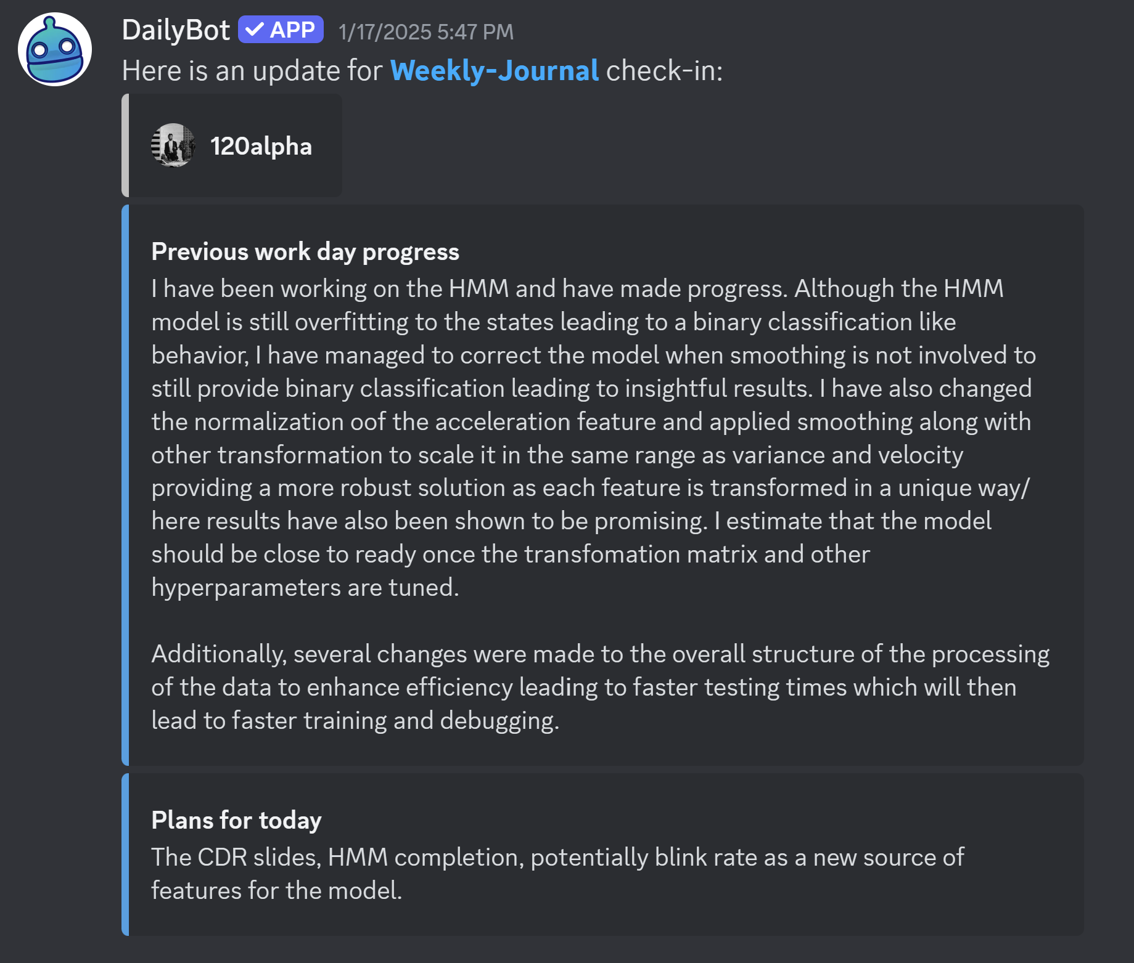
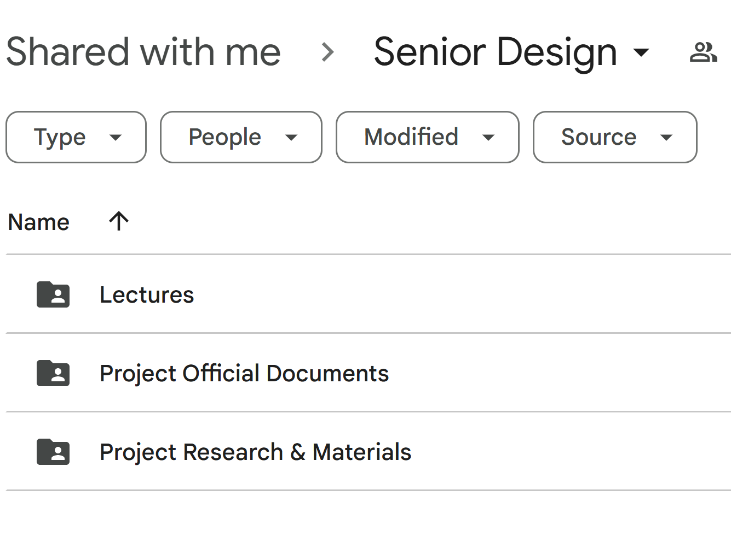
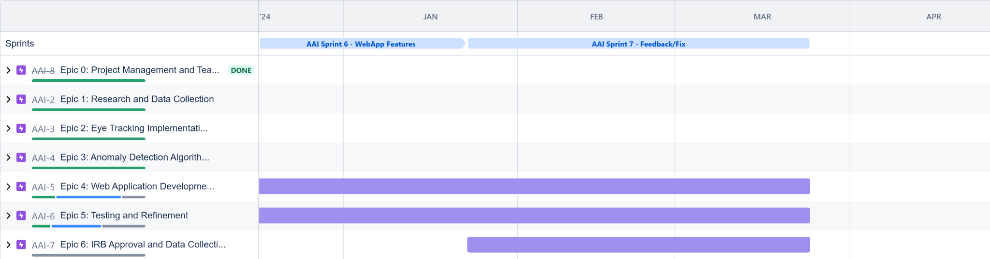
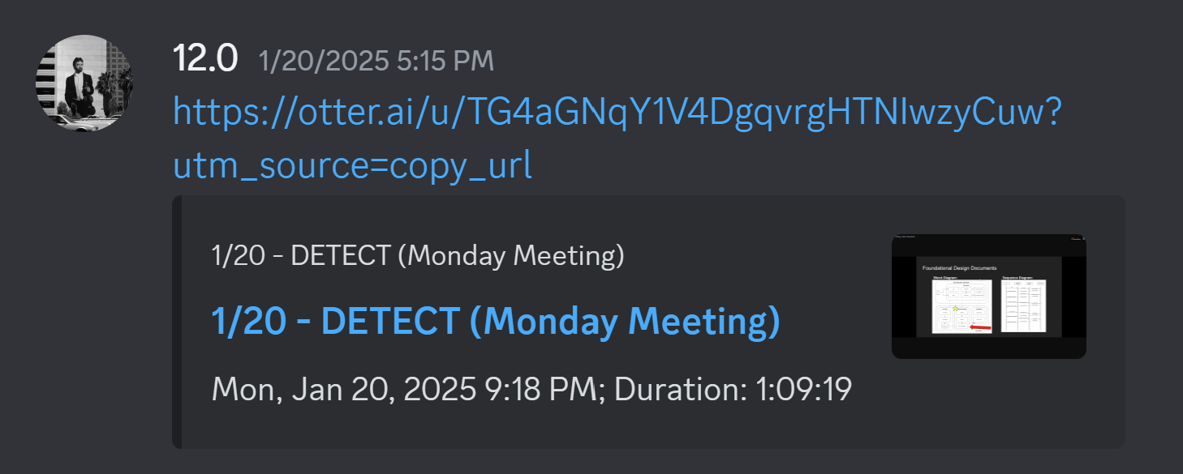
Administrative Tools
JIRA: Project timeline and structure
Zoom: Weekly meetings
Discord: Communication
Drive: Documentation and storage
Github: Code Version Control

Slide 6
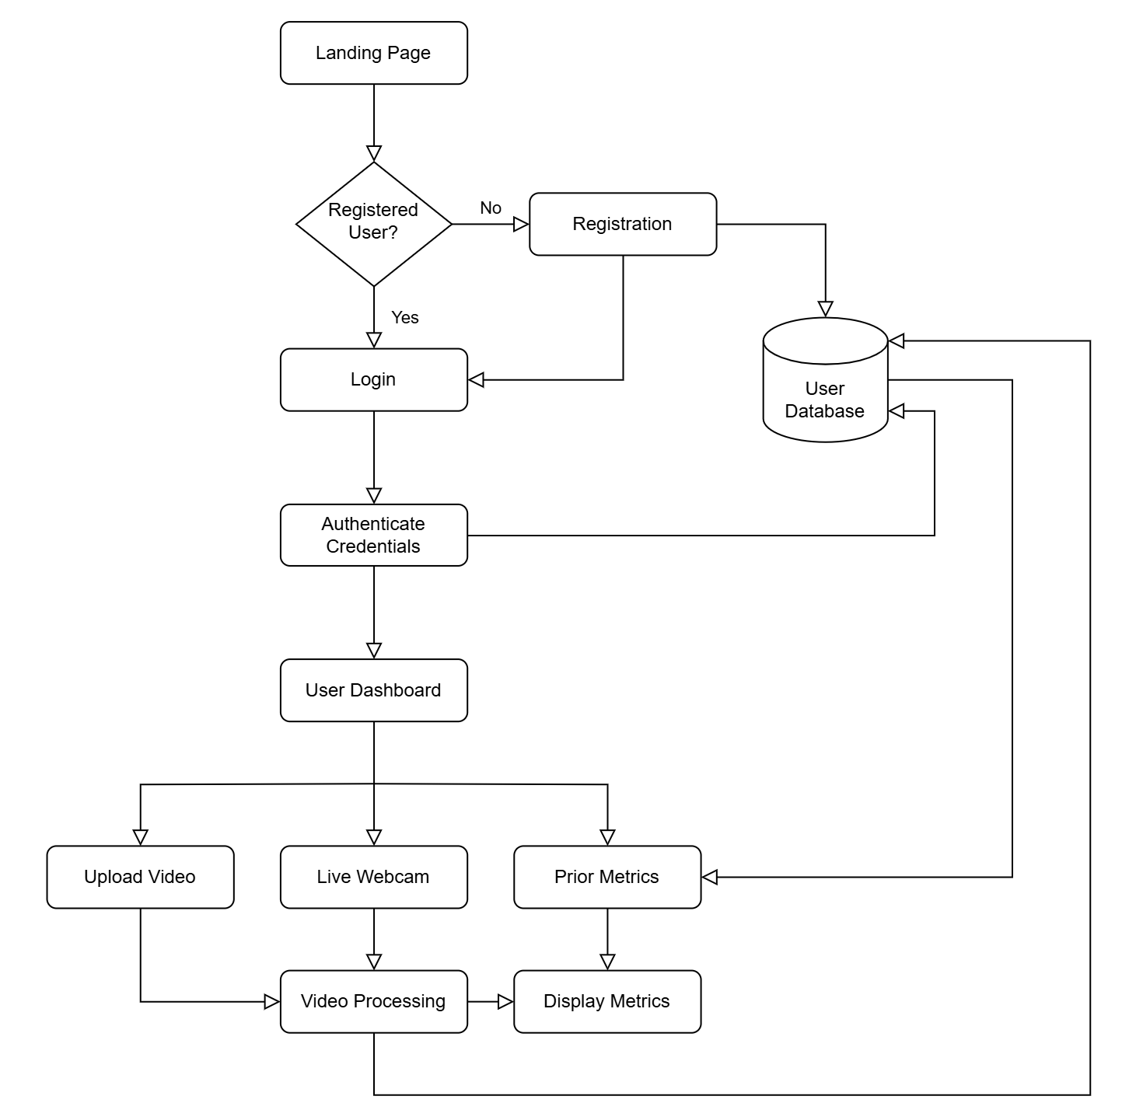
Use Case Diagram

Slide 7
Tech Stack
MediaPipe Facemesh: Extracts raw gaze data
PostgreSQL: Database for user and session data.
Astro.js: Javascript Framework for building and rendering the UI.
Go: Backend Server API language.
Docker: Package management, setup, and deployment.
Digital Ocean: Hosting for the Full Stack Application.

Slide 8
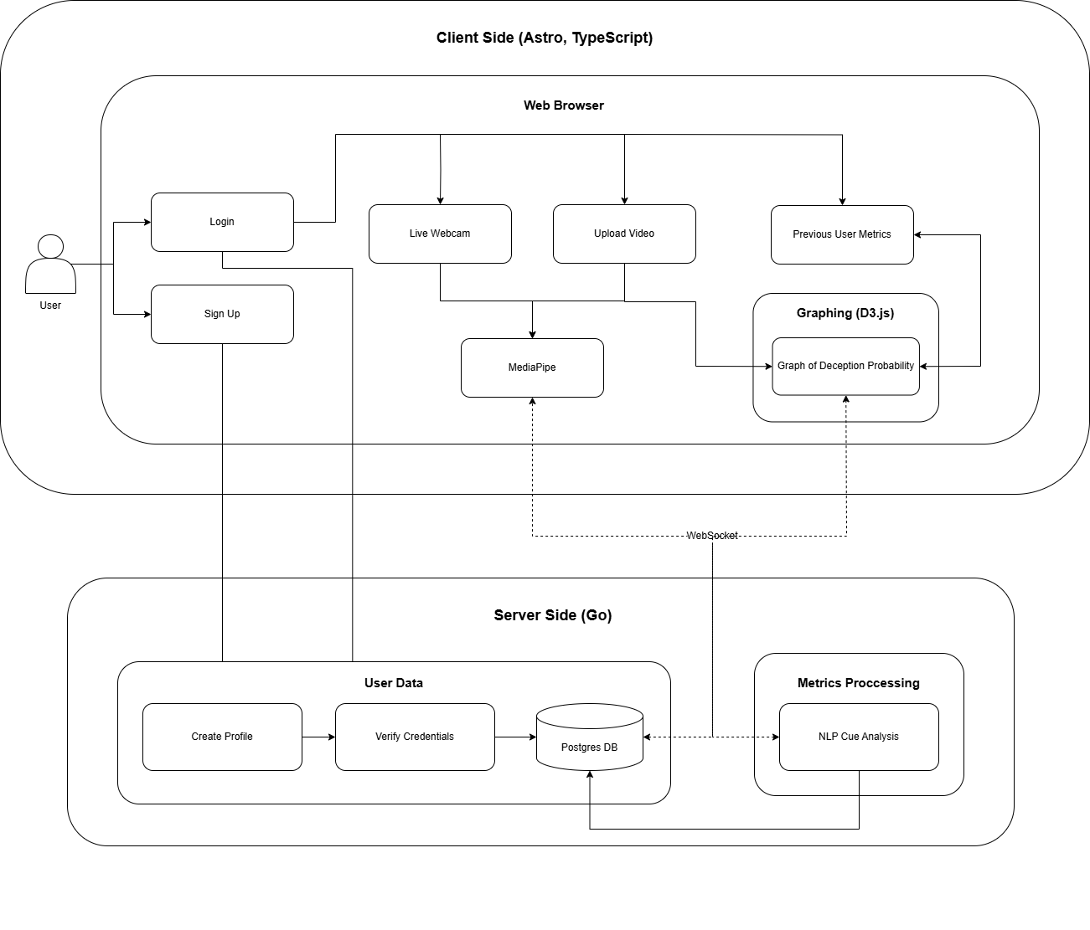
Block Diagram

Slide 9
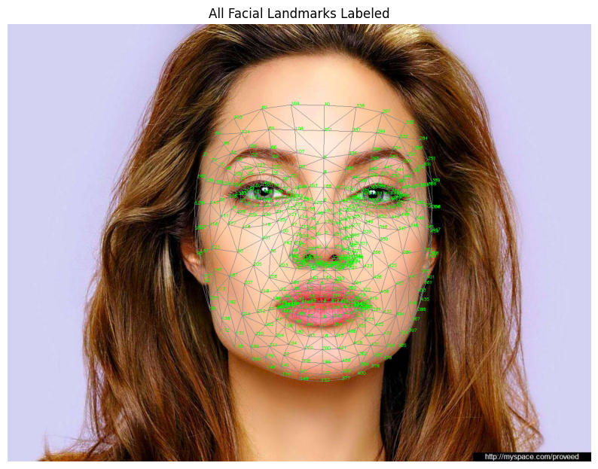
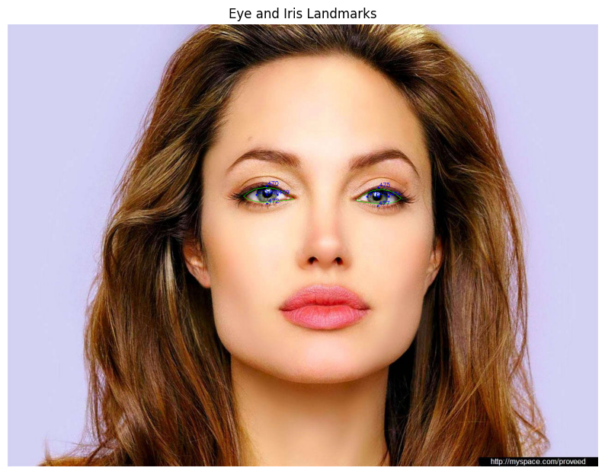
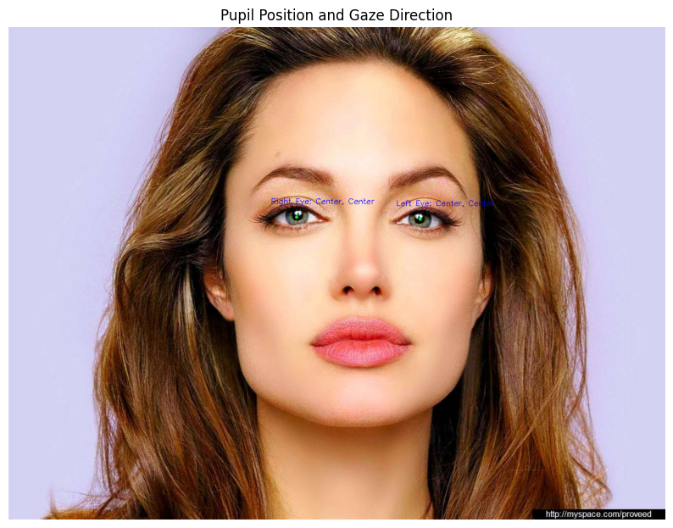
MediaPipe Overview
Google open-source framework for building perception pipelines.
Facemesh: Detects and maps 468 facial landmarks for precise tracking.
Processes input on frontend for gaze tracking -> server

Slide 10
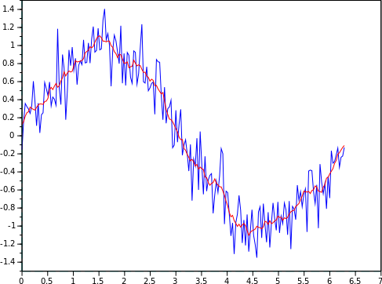
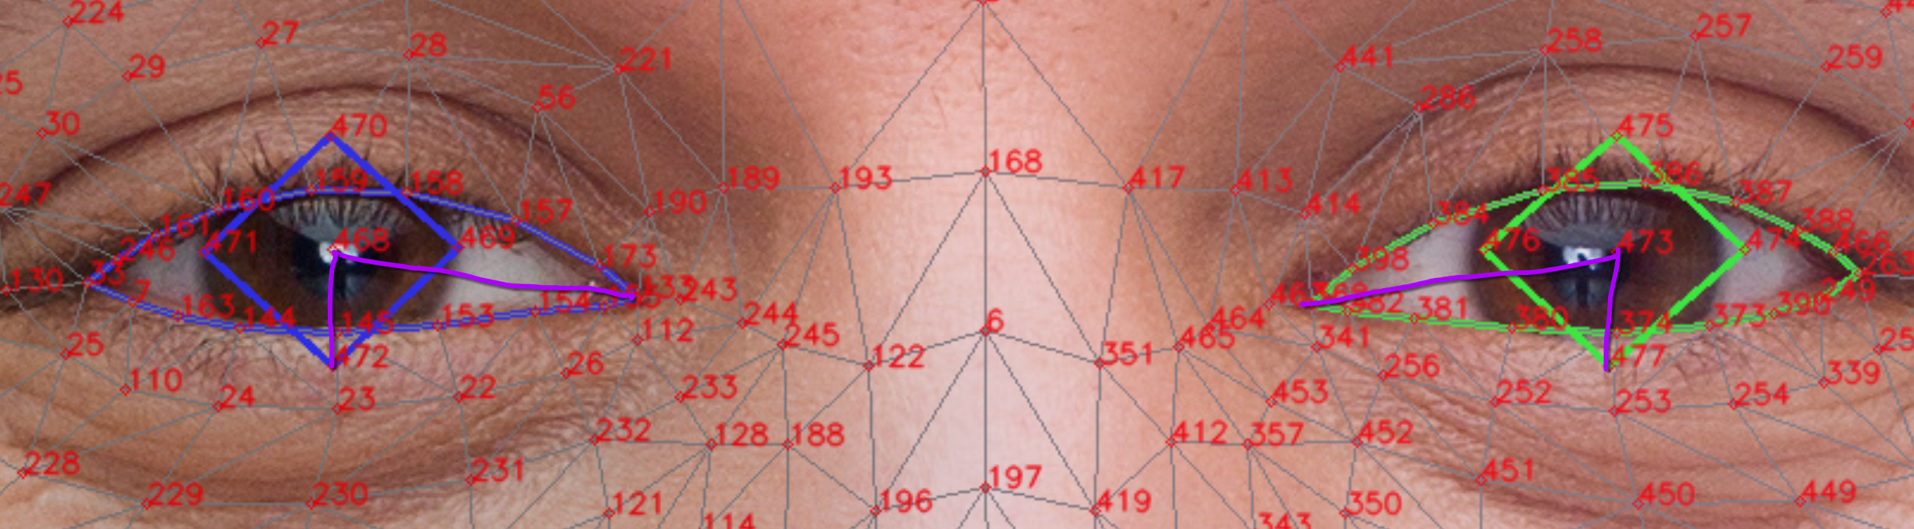
MediaPipe Implementation – Version 1
Configured via CLI arguments with a 9-region directional display.
Used Moving Average Filtering for basic noise reduction (45% acc).

Slide 11
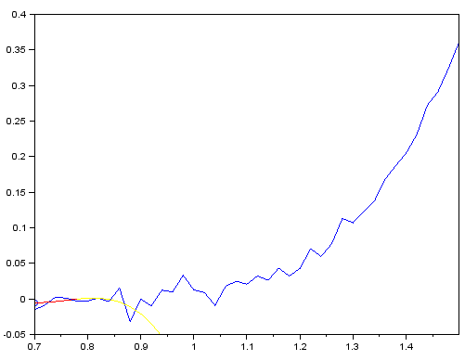
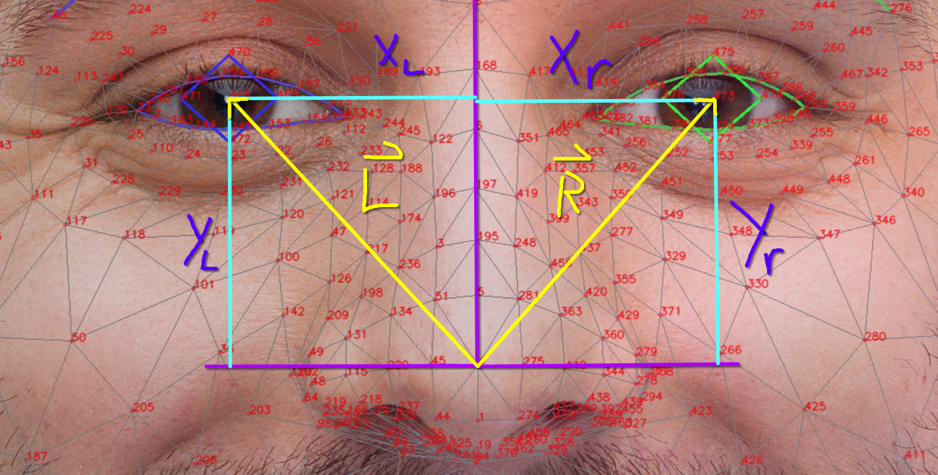
MediaPipe Implementation – Version 2
Replaced filtering with Savitzky-Golay for better signal smoothing.
Used eye-nose vector, reaching 80% accuracy.

Slide 12
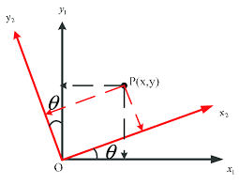
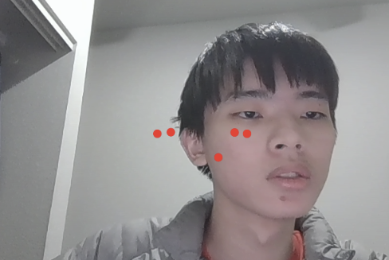
MediaPipe Implementation – Version 3
Contour recognition and affine transformations
Improve robustness against head movement and varying angles.

Slide 13
Analysis
(X, Y, time) -> deterministic deception analysis algorithm.
Computes variance (gaze dispersion) & acceleration (sudden shifts).
Predefined Min-Max normalization to scale values between 0 and 1.
Repeat steps 2 and 3 for each gaze point.
Recalculates Min/Max from session data, ensuring consistent results.

Slide 14
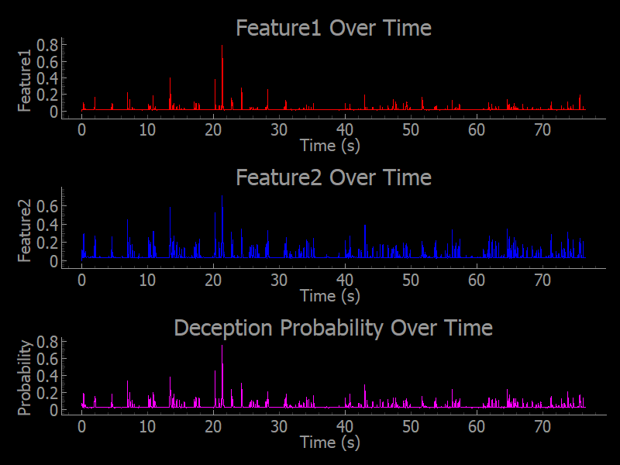
Analysis

Slide 15
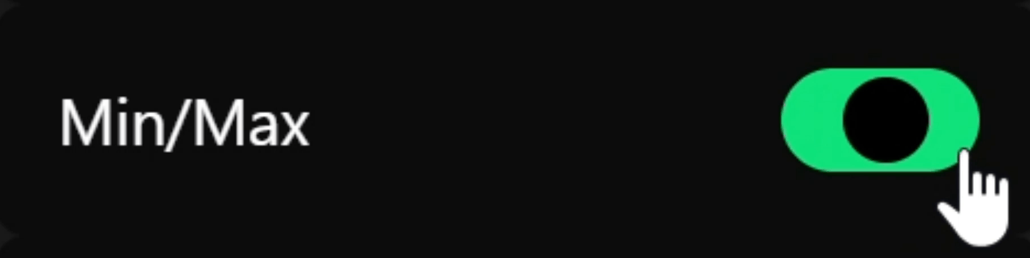
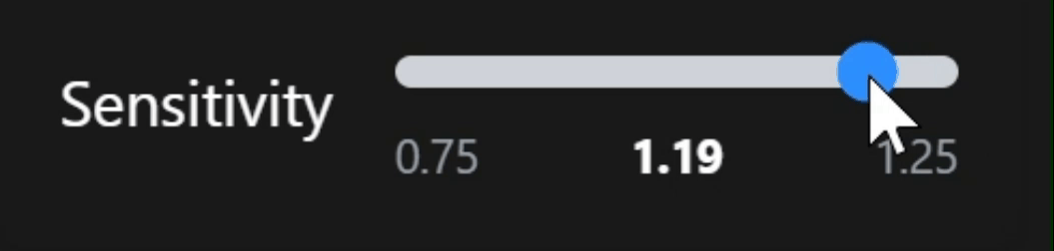
Analysis Settings
Sensitivity adjusts strictness in probability calculations.
Average Min/Max across previous sessions to adapt to user behavior.

Slide 16
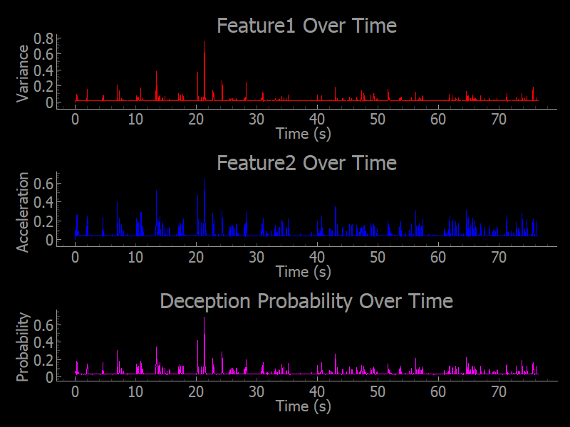
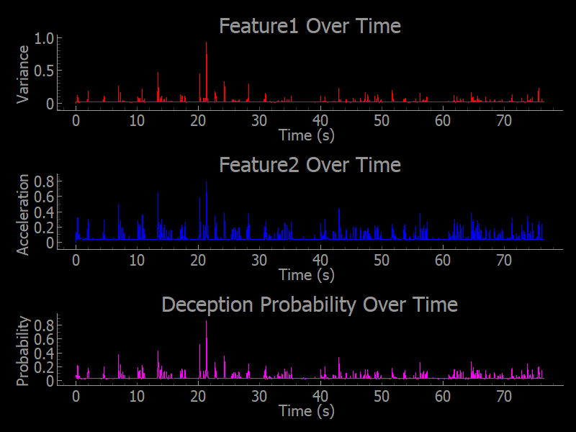
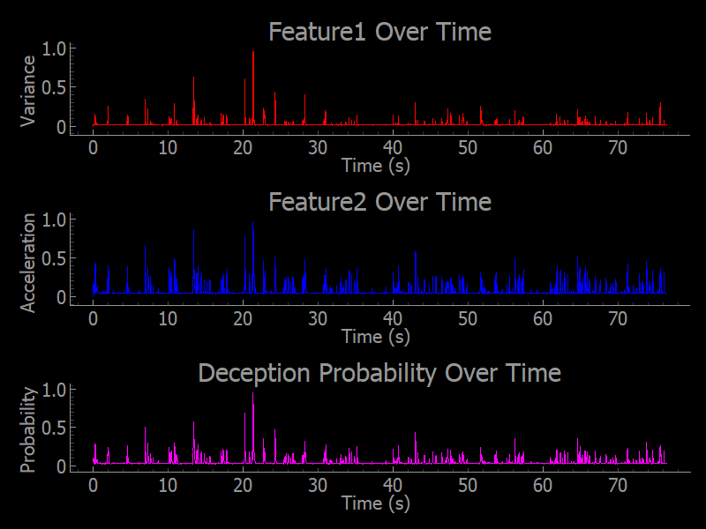
Analysis Sensitivity
1.25
1.00
0.75

Slide 17

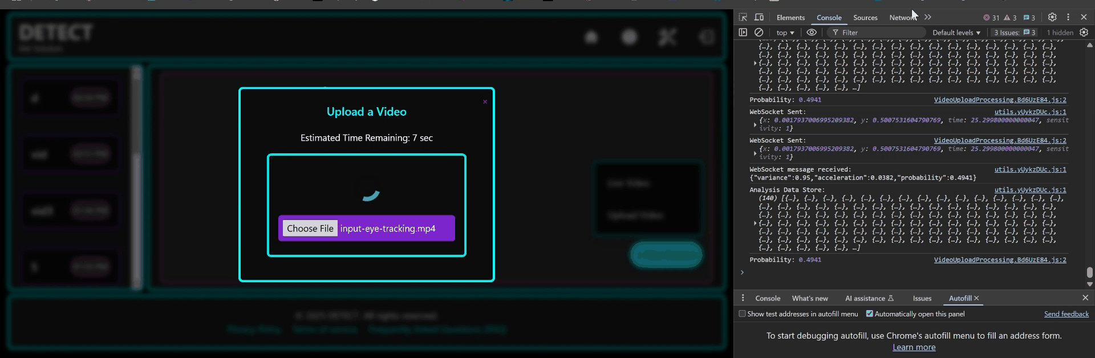
WebSockets
Gorilla WebSocket library enables passing of gaze data between the client and server.

Slide 18
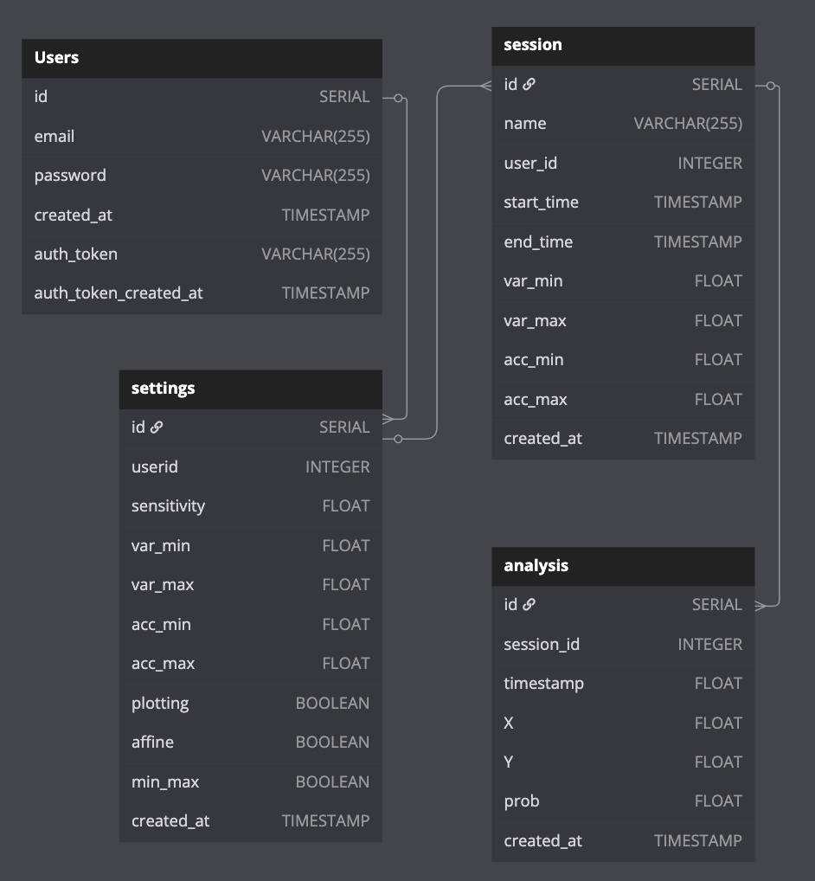
Database

Slide 19


Project Overview for Deployment
Two distinct repositories:
  Frontend (User Interface): Built and deployed using Astro build
  Backend/DB (Server): Managed using a unified docker
Separate dev (beta) and production builds for structured testing.
Designed for streamlined developer experience and faster iteration

Slide 20



Architecture and Hosting
Single Digital Ocean Droplet (Virtual Private Server) for hosting.
Hosted both environments on the same server (droplet).
Centralized Management
Optimized websocket connections and APIs for enhanced performance.
Centralized Hosting minimizes latency and app responsiveness.

Slide 21
DEMO
https://asdqwe.online/

